Slide 1
Analysis of
Ticketmaster
API Data
Names:
Alex Gamboa, Dikshant Dhall, Songlin Liu, Dennis Irwin

Slide 2
Core Message:
We believe that there are core similarities about events and venues across the nation.
Questions:
What are the different types of event from the data? What are the Sub Genre of events?
Are there any correlations with having a outside promoter vs. using the venues own promoter?
What were the best times to hold a event based on the different types of events?

Slide 3
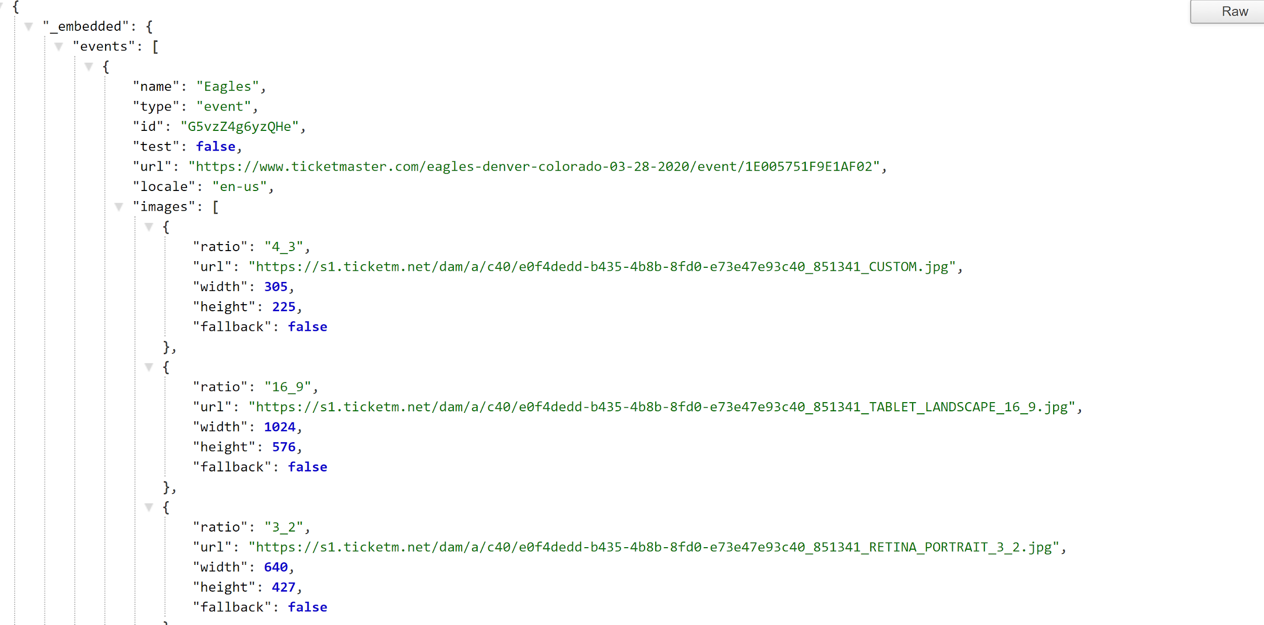
How to get the Ticket Master API

Slide 4
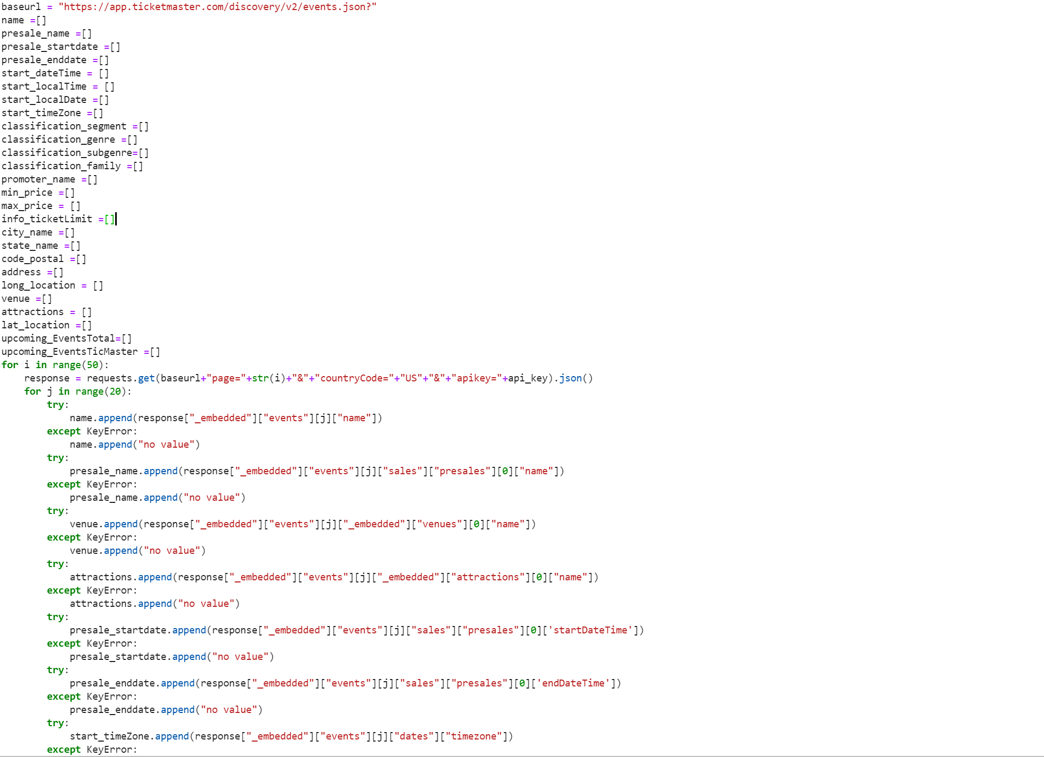
Categorizing the
Information in Pandas
And Plot with
Mat plot lib

Slide 5
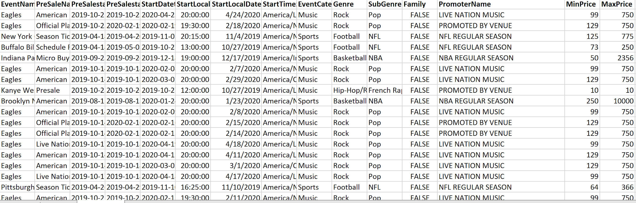
What the CSV file looks like:

Slide 6
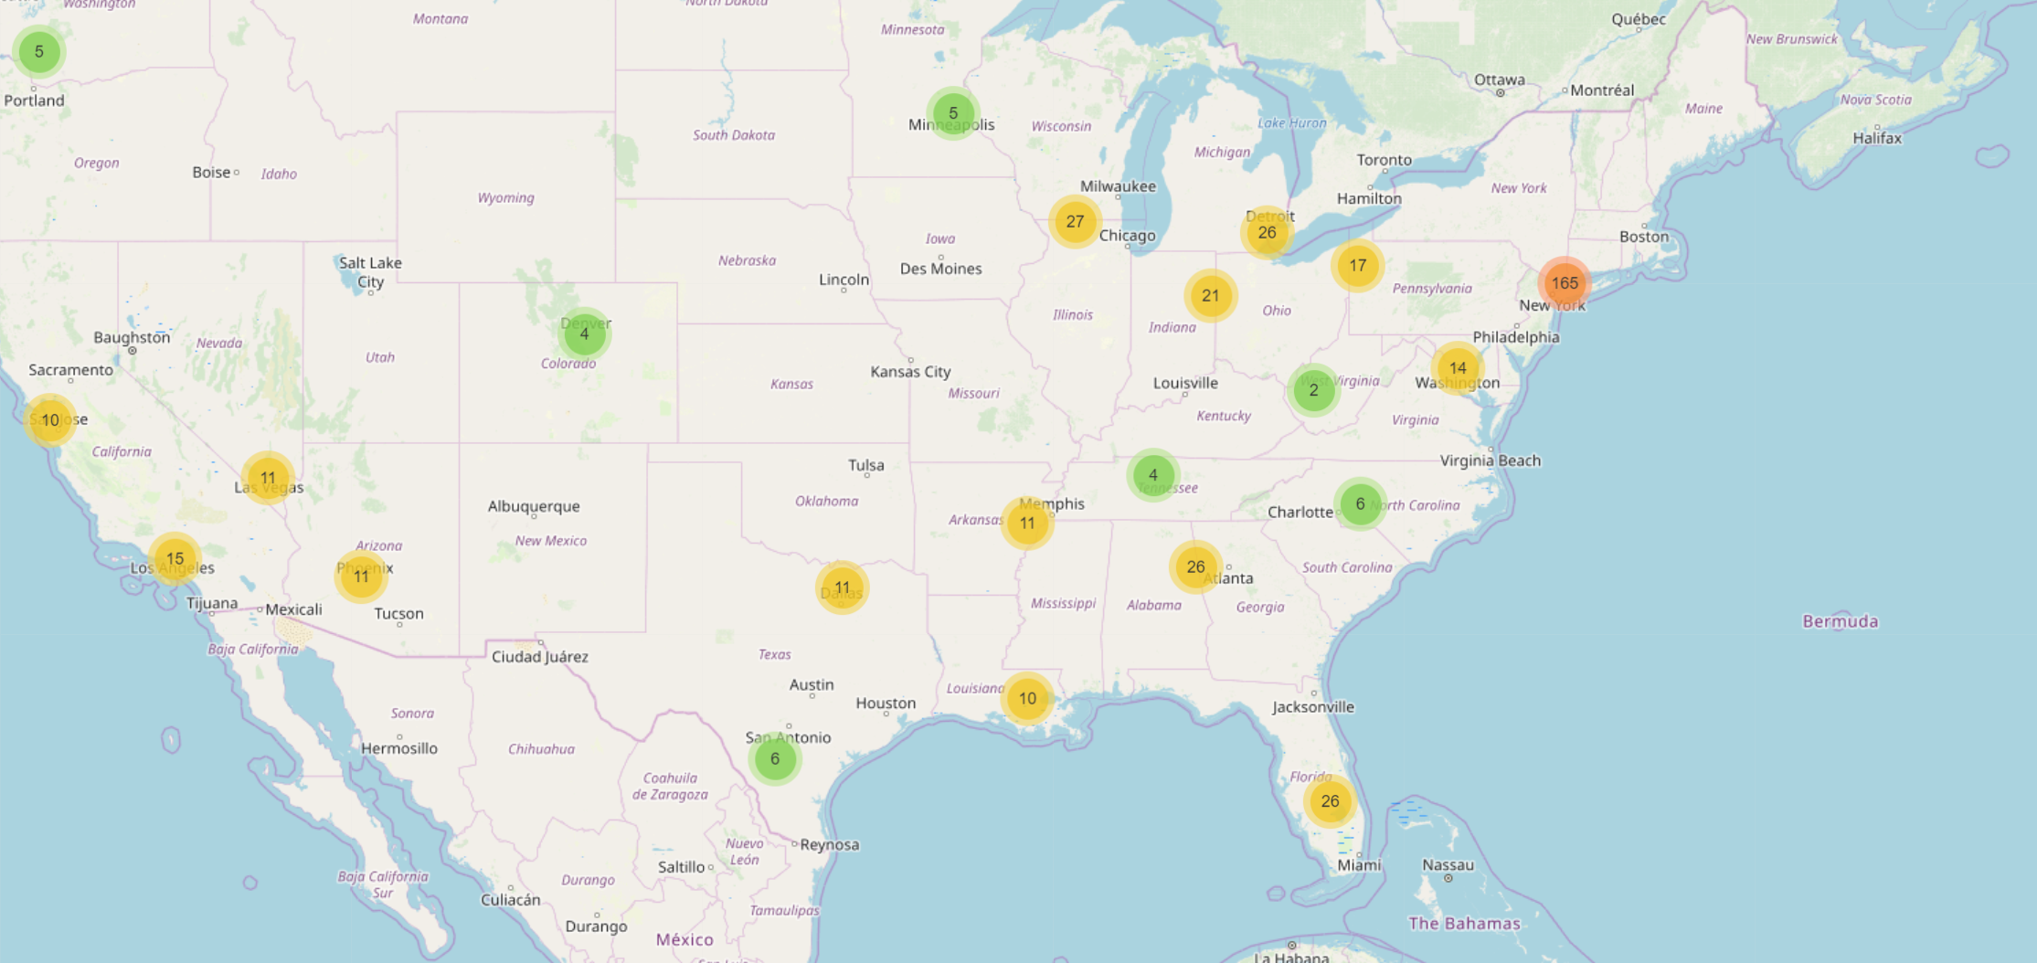
Using Google Maps API to display the Ticketmaster venues data

Slide 7
This Venue Management company wants to buy theatres and concert venues. They have hired our Consulting group to find out what other venue groups are doing.
If all acts were the same how do you run a successful venue business?
What are some common similarities within the nations venues?
Where are the current venues? Can you map them?

Slide 8
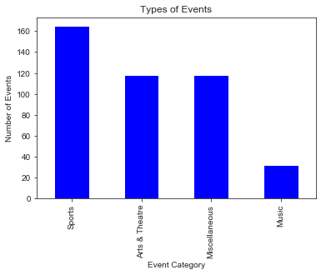
What are your types of events?
Criteria:
Use data from multiple types of
events from around the nation.

Slide 9
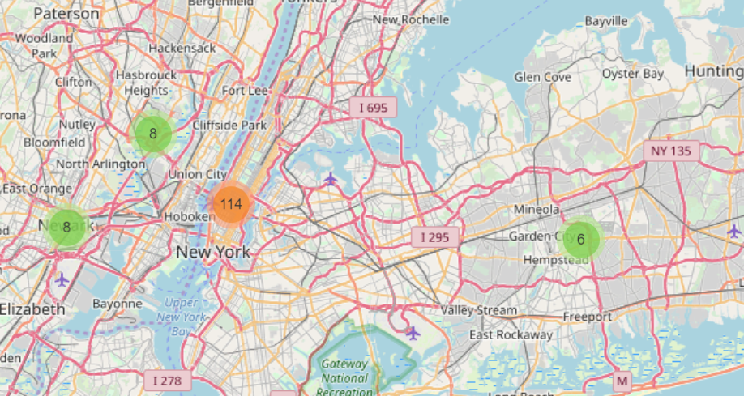
We can find the venues by geographical location using google API

Slide 10
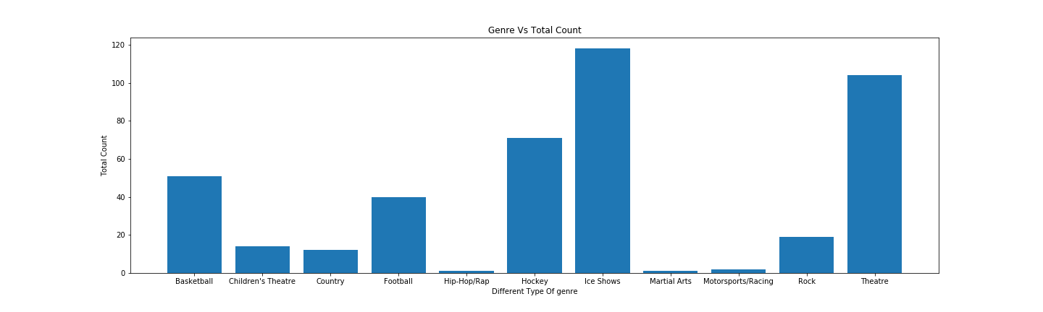
Types of Events from the From the Data

Slide 11
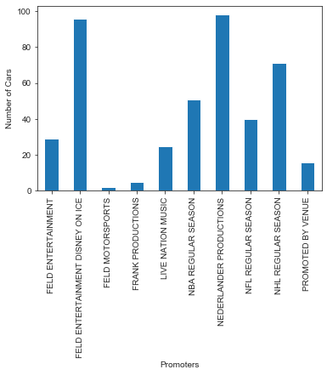
Are these events happening with a Promoter?
Yes!
Should the Venue Management Company have its own promotion side of the business?
It can be useful to hire a promoter for these events.

Slide 12
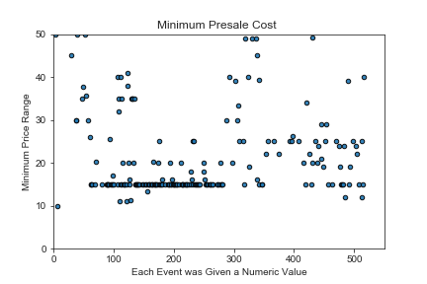
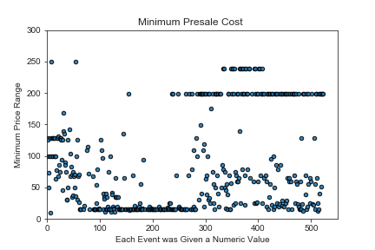
What are the minimum pre sale cost of a ticket?

Slide 13
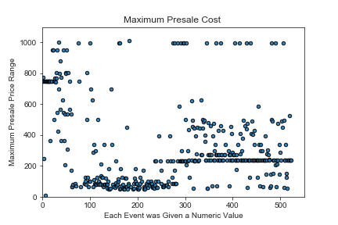
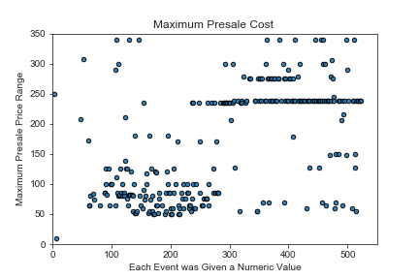
What are the maximum pre sale cost of a ticket for all types of events?

Slide 14
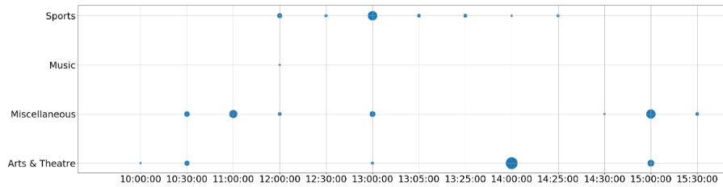
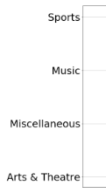
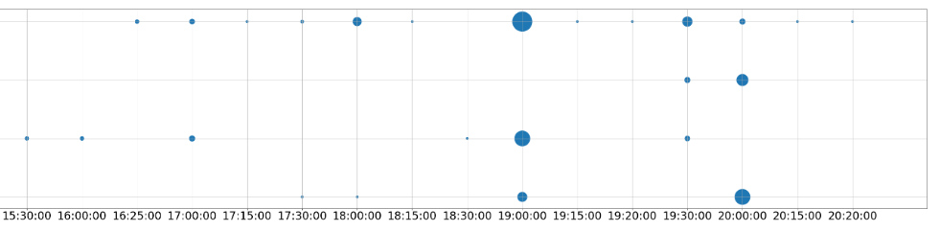
What is the most popular start time for each type of events？

Slide 15
Conclusions:
We can use Google Maps API Data to zoom into each of the geographical location and find a potential venue.
No matter what type of venue you have it is important to work with a promoter if you want more events.
There is a difference of pre sale tickets based on who’s performing
Each type of event has its most popular start time:
Sports events: 7:00 PM, 6:00 PM, & 7:30 PM
Music: 8:00 PM
Art & Theatre: 8:00 PM and 7:00 PM
Miscellaneous: 7:00 PM

Slide 16
Q & A

